Slide 1
CMSC201
Computer Science I for Majors
Lecture 19 – Recursion
Prof. Katherine Gibson
Based on slides from the book author, and previous iterations of the course

Slide 2
Last Class We Covered
Project 1 Details
Classes
Inheritance

Slide 3
Any Questions from Last Time?

Slide 4
Today’s Objectives
To introduce recursion
To begin to learn how to “think” recursively
To better understand the concept of stacks

Slide 5
Introduction to Recursion

Slide 6
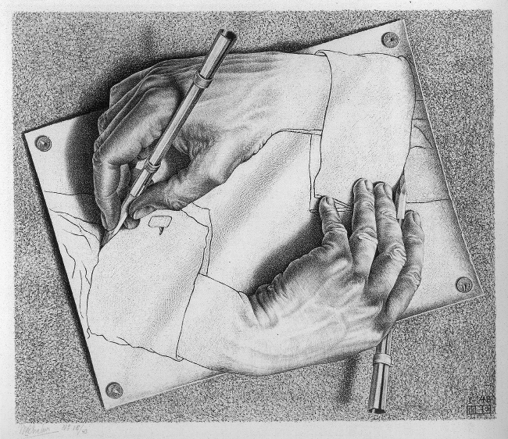
M.C. Escher:
"Drawing Hands" (1948)

Slide 7
What is Recursion?
In computer science, recursion is a way of thinking about and solving problems
It’s actually one of the central ideas of CS
Solving a problem using recursion means the solution depends on solutions to smaller instances of the same problem

Slide 8
Recursive Procedures
When creating a recursive procedure, there are a few things we want to keep in mind:
  We need to break the problem into
  smaller pieces of itself
  We need to define a “base case” to stop at
  The smaller problems we break down into need to eventually reach the base case

Slide 9
Normal vs Recursive Functions
So far, we’ve had functions call other functions
  For example, main() calls the square() function
A recursive function, however, calls itself
main()
square()
compute()

Slide 10
Why Would We Use Recursion?
In computer science, some problems are more easily solved by using recursive methods
For example:
  Traversing through a directory or file system
  Traversing through a tree of search results
  Some sorting algorithms recursively sort data
For today, we will focus on the basic structure of using recursive methods

Slide 11
Simple Recursion Example
def compute(intInput):
print(intInput)
if (intInput > 2):
compute(intInput-1)
def main():
compute(50)
main()
This is where the recursion occurs.
You can see that the compute() function calls itself.
This program simply computes from 50 down to 2.

Slide 12
Visualizing Recursion
To understand how recursion works, it helps to visualize what’s going on.
To help visualize, we will use a common concept called the Stack.
A stack basically operates like a container of trays in a cafeteria. It has only two operations:
  Push: you can push something onto the stack.
  Pop: you can pop something off the top of the stack.
Let’s see an example stack in action.

Slide 13
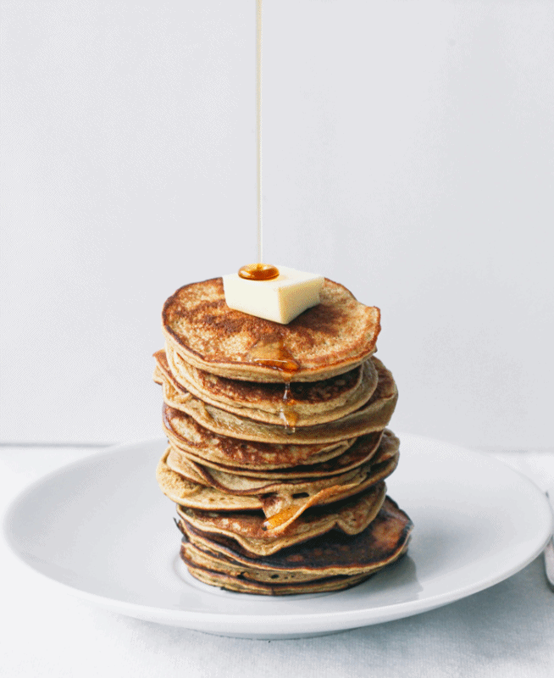
Stacks

Slide 14
Stacks
The diagram below shows a stack over time.
We perform two pushes and two pops.
8
2
2
2
Time: 0
Empty Stack
Time 1:
Push “2”
Time 2:
Push “8”
Time 3:
Pop: Gets 8
Time 4:
Pop: Gets 2

Slide 15
Stacks
In computer science, a stack is a last in, first out(LIFO) abstract data type and data structure.
A stack can have any abstract data type as an element, but is characterized by only two fundamental operations, the push and the pop.
The push operation adds to the top of the list, hiding any items already on the stack, or initializing the stack if it is empty.

Slide 16
Stacks
The nature of the pop and push operations also means that stack elements have a natural order.
Elements are removed from the stack in the reverse order to the order of their addition: therefore, the lower elements are typically those that have been in the list the longest.

Slide 17
Stacks and Functions
When you run a program, the computer creates a stack for you.
Each time you invoke a function, the function is placed on top of the stack.
When the function returns or exits, the function is popped off the stack.

Slide 18
Stacks and Functions
square()
main()
main()
main()
Time: 0
Empty Stack
Time 1:
Push: main()
Time 2:
Push: square()
Time 3:
Pop: square()
returns a value.
method exits.
Time 4:
Pop: main()
returns a value.
method exits.
This is called an activation record or stack frame.
Usually, this actually grows downward.

Slide 19
Stacks and Recursion
Each time a function is called, you push the function on the stack.
Each time the function returns or exits, you pop the function off the stack.
If a function calls itself recursively, you just push another copy of the function onto the stack.
We therefore have a simple way to visualize how recursion really works.

Slide 20
Back to the Simple Recursion Program
def compute(intInput):
print(intInput)
if (intInput > 2):
compute(intInput-1)
def main():
compute(50)
main()
Here’s the code again. Now, that we understand stacks, we can visualize the recursion.

Slide 21
Stack and Recursion in Action
compute(7)
compute(8)
compute(8)
compute(9)
compute(9)
compute(9)
main()
main()
main()
main()
…
Time: 0
Empty Stack
Time 1:
Push: main()
Time 2:
Push: compute(9)
Time 3:
Push: compute(8)
Time 4:
Push: compute(7)
After returning
from compute(2)
pop everything
Inside compute(9):
print (intInput); → 9
if (intInput > 2)
compute(intInput-1);
Inside compute(8):
print (intInput); → 8
if (intInput > 2)
compute(intInput-1);
Inside compute(7):
print (intInput); → 7
if (intInput > 2)
compute(intInput-1);

Slide 22
Defining Recursion

Slide 23
Terminology
base
case
recursive
case
def f(n):
if n == 1:
return 1
else:
return f(n - 1)
"Useful" recursive functions have:
at least one recursive case
at least one base case
so that the computation terminates

Slide 24
Recursion
def f(n):
if n == 1:
return 1
else:
return f(n + 1)
Find f(5)
We have a base case and a recursive case. What's wrong?

Slide 25
Recursion
The recursive case
should call the function
on a simpler input,
bringing us closer and closer
to the base case.

Slide 26
Recursion
def f(n):
if n == 0:
return 0
else:
return 1 + f(n - 1)
Find f(0)
Find f(1)
Find f(2)
Find f(100)

Slide 27
Recursion
def f(n):
if n == 0:
return 0
else:
return n + f(n - 1)
f(3)
3 + f(2)
3 + 2 + f(1)
3 + 2 + 1 + f(0)
3 + 2 + 1 + 0
6

Slide 28
Factorial
4! = 4 × 3 × 2 × 1 = 24

Slide 29
Factorial
Does anyone know the value of 9! ?
362,880
Does anyone know the value of 10! ?
How did you know?

Slide 30
Factorial
9! = 9×8×7×6×5×4×3×2×1
10! = 10 × 9×8×7×6×5×4×3×2×1
10! = 10 × 9!
n! = n × (n - 1)!
That's a recursive definition!

Slide 31
Factorial
def fact(n):
return n * fact(n - 1)
fact(3)
3 × fact(2)
3 × 2 × fact(1)
3 × 2 × 1 × fact(0)
3 × 2 × 1 × 0 × fact(-1)
...

Slide 32
Factorial
What did we do wrong?
What is the base case for factorial?

Slide 33
Any Other Questions?

Slide 34
Announcements
Lab has been cancelled this week!
  Work on your project instead
Project 1 is out
  Due by Tuesday, November 17th at 8:59:59 PM
  Do NOT procrastinate!
Next Class: Recursion

